Slide 1
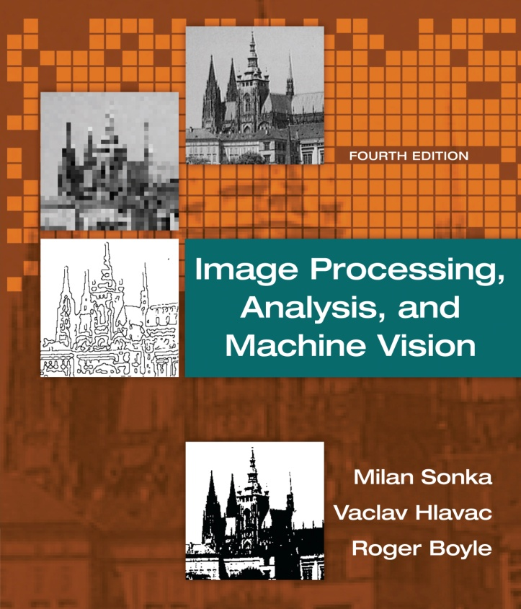

Chapter 5
Image Processing, Analysis, and Machine Vision, 4th Edition Sonka, Hlavac & Boyle
Image pre-processing

Slide 2
Image pre-processing
Image Processing, Analysis, and Machine Vision, 4th Edition Sonka, Hlavac & Boyle
Pixel brightness transformations
Geometric transformations
Local pre-processing
Image smoothing, edge detection, line detection, corner detection, and region detection.
Image restoration

Slide 3
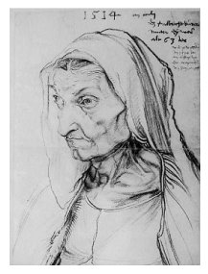
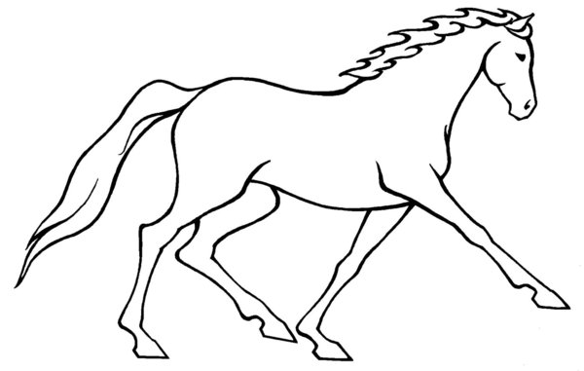
Edge detectors
Image Processing, Analysis, and Machine Vision, 4th Edition Sonka, Hlavac & Boyle
Edge detectors are a collection of very important local image pre-processing methods used to locate changes in the intensity function.
Edges are pixels where the intensity function (brightness) changes abruptly.
If only edge elements with strong magnitude are considered, such information often suffices (足夠) for image understanding.
For example, line drawing images.
http://kelpie77.deviantart.com/art/line-art-horse-123352124

Slide 4
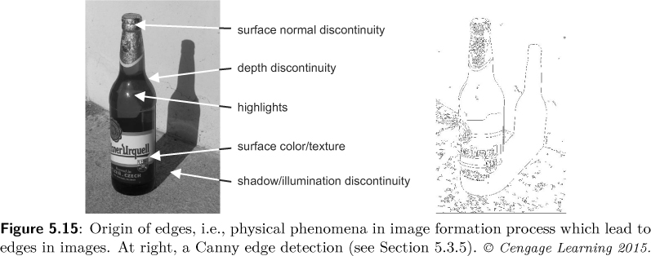
Edge detectors
Image Processing, Analysis, and Machine Vision, 4th Edition Sonka, Hlavac & Boyle
Physical phenomena (現象) in the image formation process lead to abrupt changes in image values

Slide 5
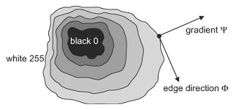
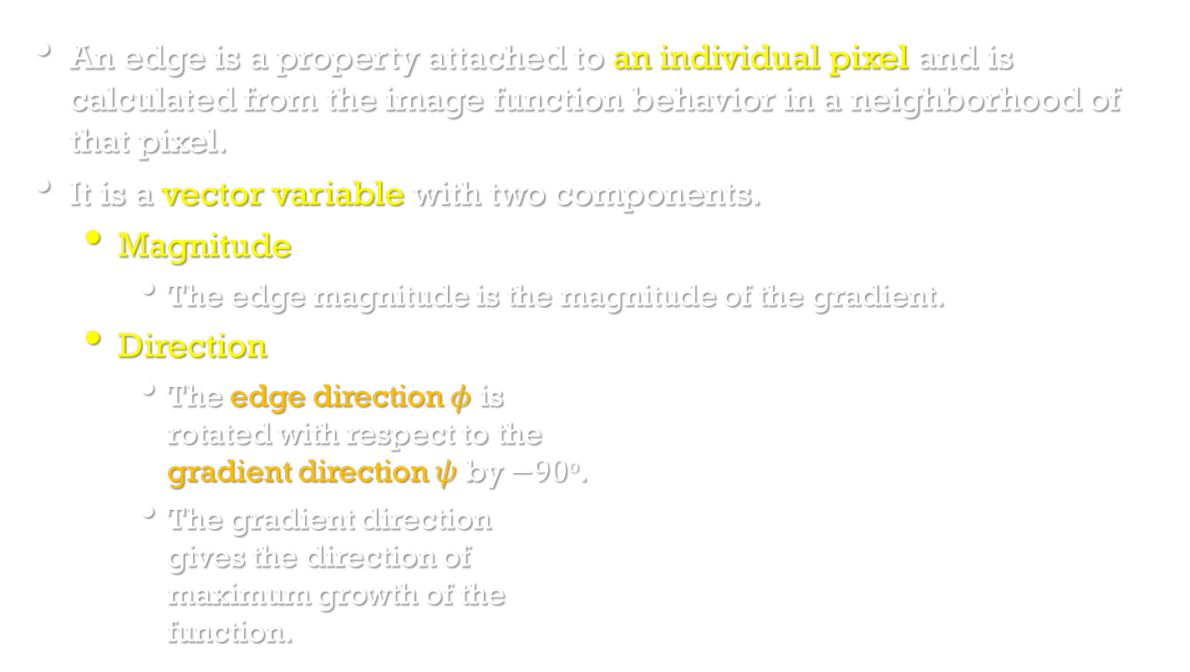
Edge detectors
Image Processing, Analysis, and Machine Vision, 4th Edition Sonka, Hlavac & Boyle
An edge is a property attached to an individual pixel and is calculated from the image function behavior in a neighborhood of that pixel.
It is a vector variable with two components.
Magnitude
The edge magnitude is the magnitude of the gradient.
Direction
The edge direction $φ$ is rotated with respect to the gradient direction $ψ$ by $−90o$.
The gradient direction gives the direction of maximum growth of the function.

Slide 6
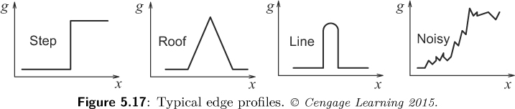
Edge detectors
Image Processing, Analysis, and Machine Vision, 4th Edition Sonka, Hlavac & Boyle
Edges are often used in image analysis for finding region boundaries.
This figure shows examples of several standard edge profile (輪廓、外形).
Edge detectors are usually tuned for some type of edge profile.

Slide 7
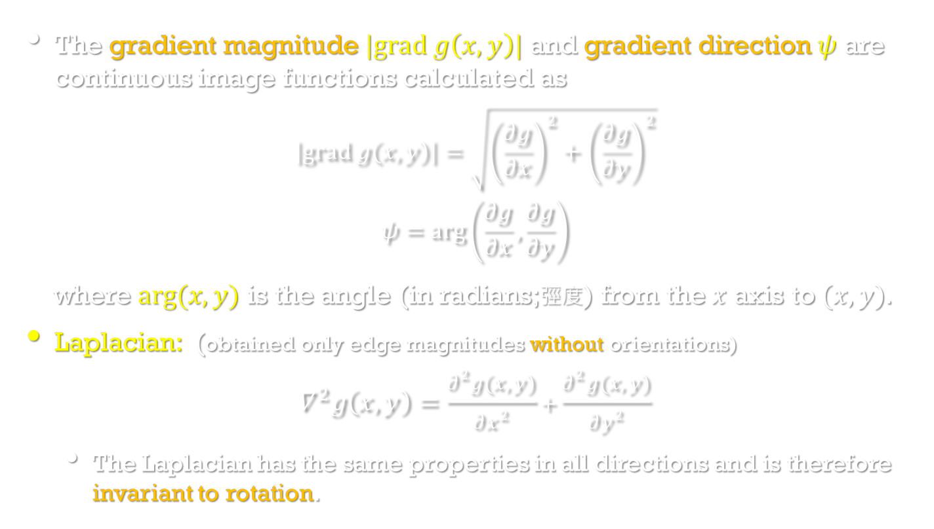
Edge detectors
Image Processing, Analysis, and Machine Vision, 4th Edition Sonka, Hlavac & Boyle
The gradient magnitude $|grad g\left(x,y\right)|$ and gradient direction $ψ$ are continuous image functions calculated as
$$\left|grad g\left(x,y\right)\right|=\sqrt{{\left(\frac{∂g}{∂x}\right)}^{2}+{\left(\frac{∂g}{∂y}\right)}^{2}}$$
$$ψ=arg\left(\frac{∂g}{∂x},\frac{∂g}{∂y}\right)$$
where $arg(x,y)$ is the angle (in radians;弳度) from the $x$ axis to $(x,y)$.
Laplacian: (obtained only edge magnitudes without orientations)
$$∇^{2}g\left(x,y\right)=\frac{∂^{2}g(x,y)}{∂x^{2}}+\frac{∂^{2}g(x,y)}{∂y^{2}}$$
The Laplacian has the same properties in all directions and is therefore invariant to rotation.

Slide 8
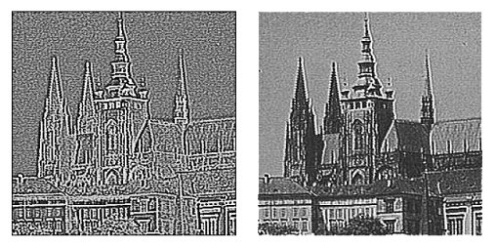
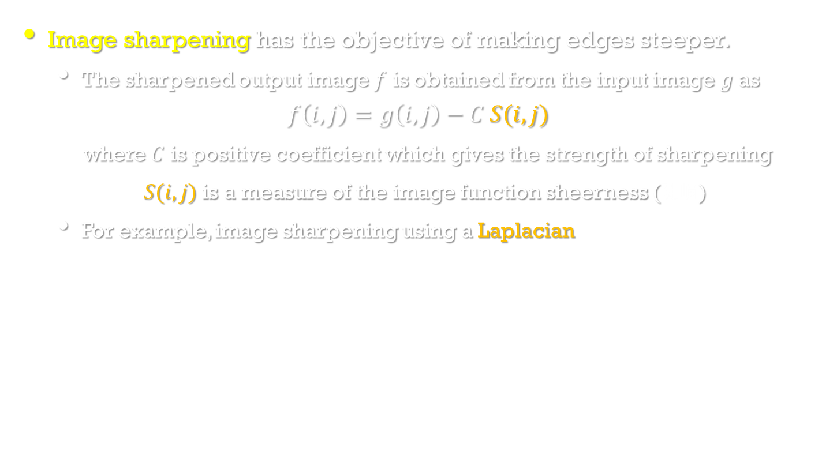
Edge detectors
Image Processing, Analysis, and Machine Vision, 4th Edition Sonka, Hlavac & Boyle
Image sharpening has the objective of making edges steeper.
The sharpened output image $f$ is obtained from the input image $g$as
$$f\left(i,j\right)=g\left(i,j\right)−C S(i,j)$$
where $C$ is positive coefficient which gives the strength of sharpening
$S(i,j)$ is a measure of the image function sheerness (陡峭)
For example, image sharpening using a Laplacian
Original image

Slide 9
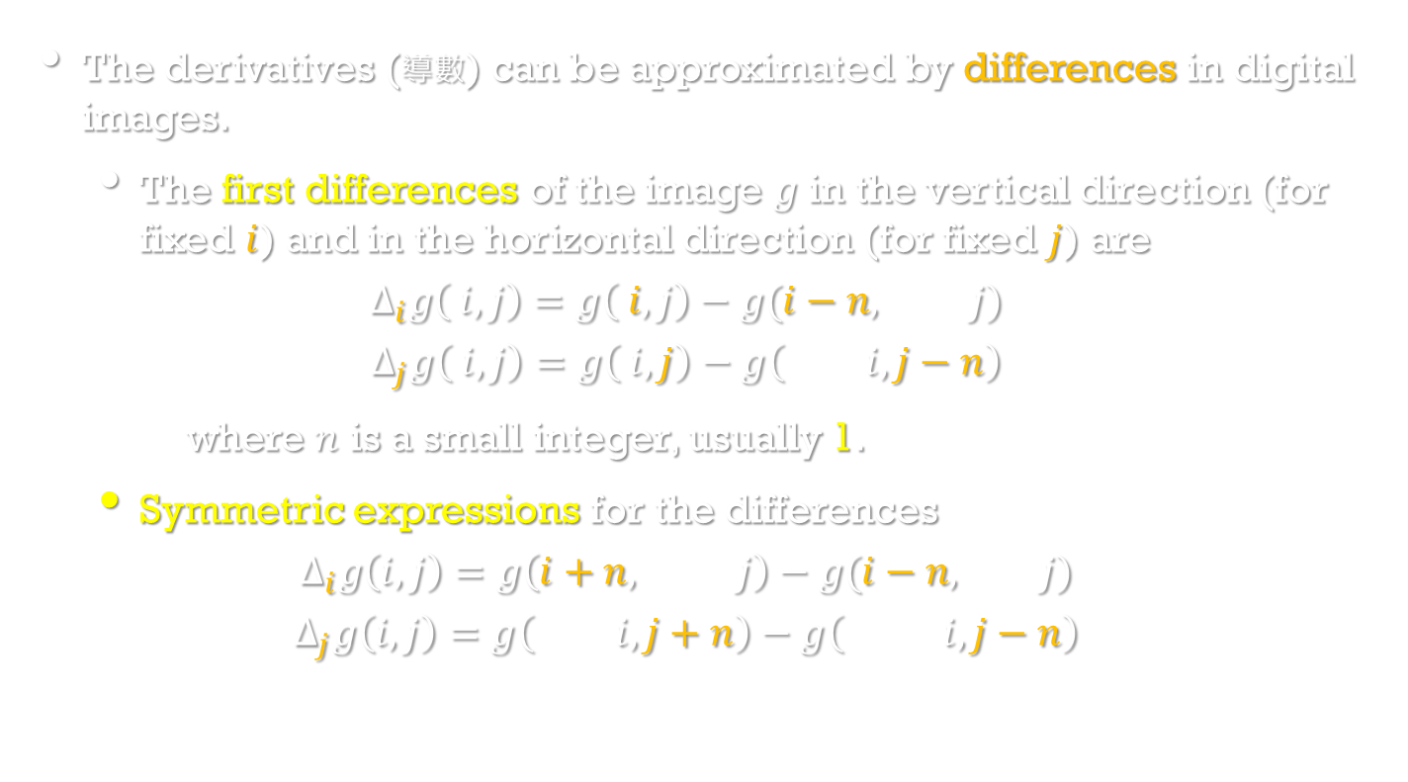
Edge detectors
Image Processing, Analysis, and Machine Vision, 4th Edition Sonka, Hlavac & Boyle
The derivatives (導數) can be approximated by differences in digital images.
The first differences of the image $g$ in the vertical direction (for fixed $i$) and in the horizontal direction (for fixed $j$) are
$$∆_{i}g\left( i, j\right)=g\left( i, j\right)−g(i−n, j)$$
$$∆_{j}g\left( i, j\right)=g\left( i, j\right)−g\left( i,j−n\right)$$
where $n$ is a small integer, usually 1.
Symmetric expressions for the differences
$$∆_{i}g\left(i,j\right)=g\left(i+n, j\right)−g(i−n, j)$$
$$∆_{j}g\left(i,j\right)=g\left( i,j+n\right)−g\left( i,j−n\right)$$

Slide 10
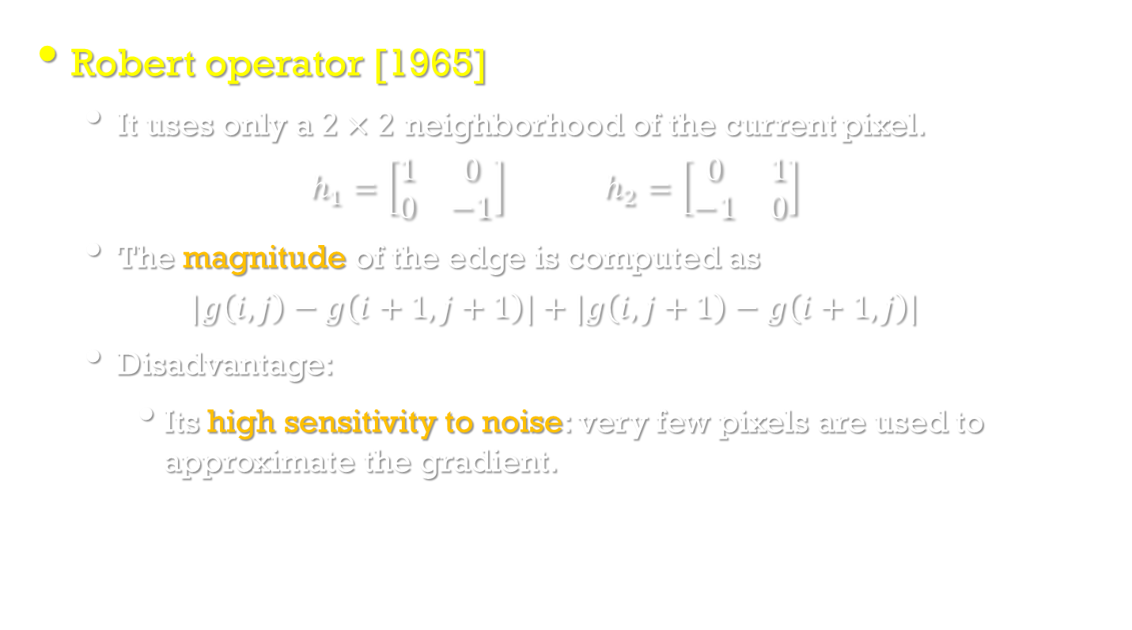
Edge detectors
Robert operator [1965]
It uses only a $2×2$ neighborhood of the current pixel.
$$h_{1}=\left[\begin{matrix}1 & 0 \\ 0 & −1\end{matrix}\right] h_{2}=\left[\begin{matrix}0 & 1 \\ −1 & 0\end{matrix}\right]$$
The magnitude of the edge is computed as
$$|g\left(i,j\right)−g\left(i+1,j+1\right)|+|g\left(i,j+1\right)−g\left(i+1,j\right)|$$
Disadvantage:
Its high sensitivity to noise: very few pixels are used to approximate the gradient.

Slide 11
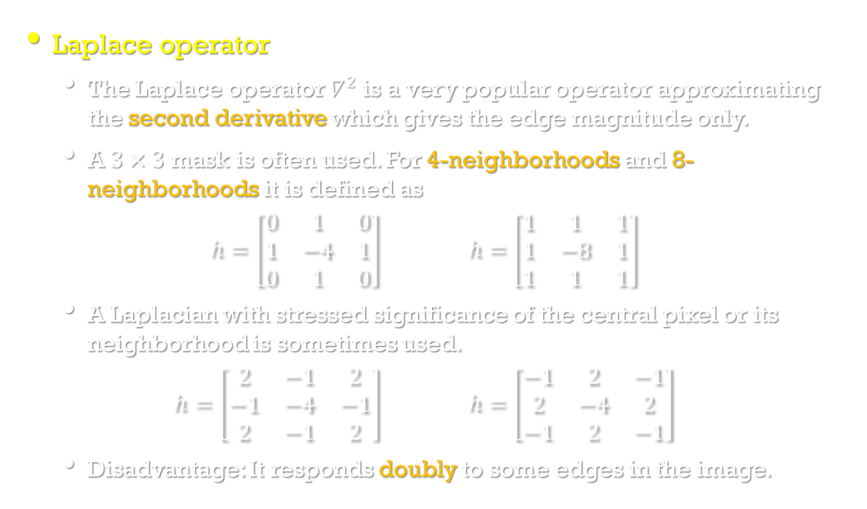
Edge detectors
Laplace operator
The Laplace operator $∇^{2}$ is a very popular operator approximating the second derivative which gives the edge magnitude only.
A $3×3$ mask is often used. For 4-neighborhoods and 8-neighborhoods it is defined as
$$h=\left[\begin{matrix}0 & 1 & 0 \\ 1 & −4 & 1 \\ 0 & 1 & 0\end{matrix}\right] h=\left[\begin{matrix}1 & 1 & 1 \\ 1 & −8 & 1 \\ 1 & 1 & 1\end{matrix}\right]$$
A Laplacian with stressed significance of the central pixel or its neighborhood is sometimes used.
$$h=\left[\begin{matrix}2 & −1 & 2 \\ −1 & −4 & −1 \\ 2 & −1 & 2\end{matrix}\right] h=\left[\begin{matrix}−1 & 2 & −1 \\ 2 & −4 & 2 \\ −1 & 2 & −1\end{matrix}\right]$$
Disadvantage: It responds doubly to some edges in the image.

Slide 12
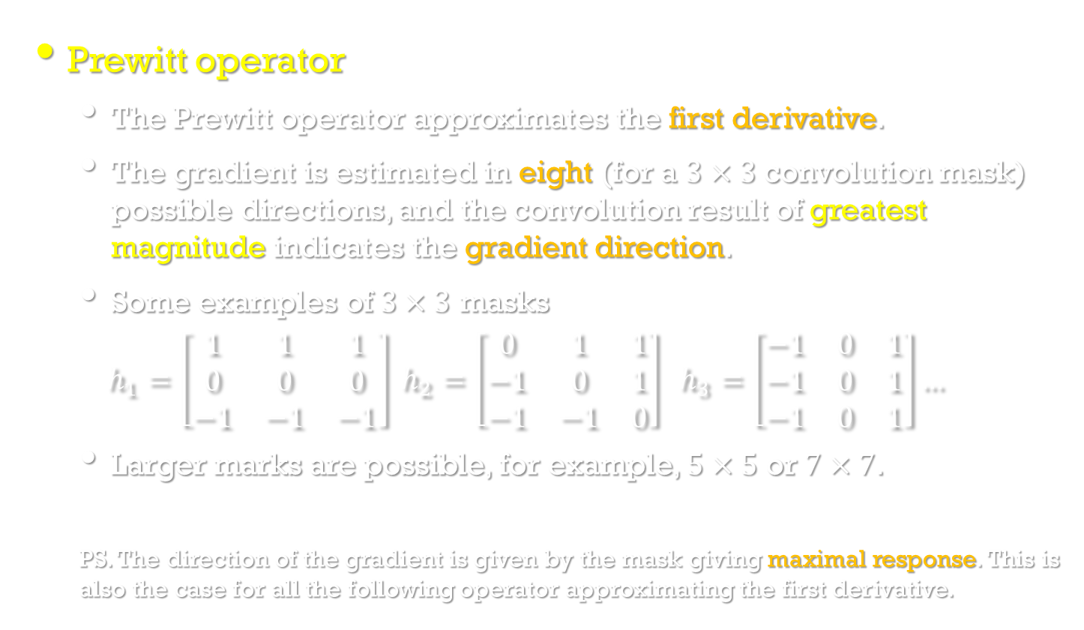
Edge detectors
Prewitt operator
The Prewitt operator approximates the first derivative.
The gradient is estimated in eight (for a $3×3$ convolution mask) possible directions, and the convolution result of greatest magnitude indicates the gradient direction.
Some examples of $3×3$ masks
$$h_{1}=\left[\begin{matrix}1 & 1 & 1 \\ 0 & 0 & 0 \\ −1 & −1 & −1\end{matrix}\right] h_{2}=\left[\begin{matrix}0 & 1 & 1 \\ −1 & 0 & 1 \\ −1 & −1 & 0\end{matrix}\right] h_{3}=\left[\begin{matrix}−1 & 0 & 1 \\ −1 & 0 & 1 \\ −1 & 0 & 1\end{matrix}\right]…$$
Larger marks are possible, for example, $5×5$ or $7×7$.
PS. The direction of the gradient is given by the mask giving maximal response. This is also the case for all the following operator approximating the first derivative.

Slide 13
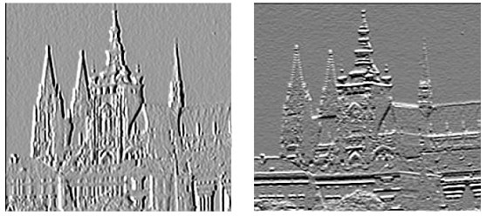
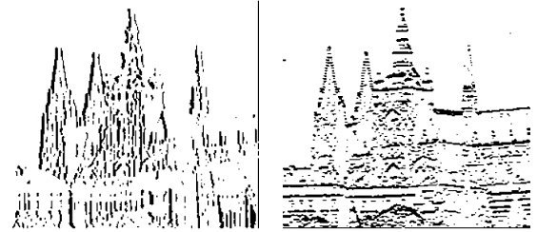
Edge detectors
Image Processing, Analysis, and Machine Vision, 4th Edition Sonka, Hlavac & Boyle
First-derivative edge detection using Prewitt operators.
North direction
The brighter the pixel value, the stronger the edge.
East direction
North
East
Strong edges

Slide 14
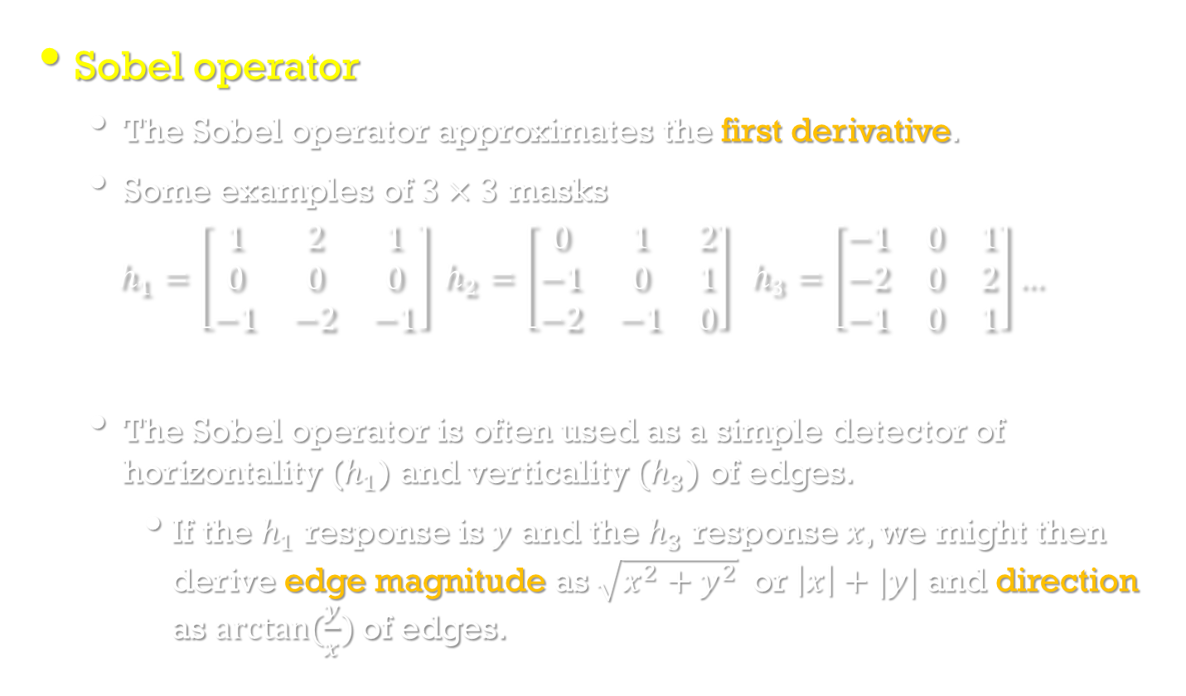
Edge detectors
Sobel operator
The Sobel operator approximates the first derivative.
Some examples of $3×3$ masks
$$h_{1}=\left[\begin{matrix}1 & 2 & 1 \\ 0 & 0 & 0 \\ −1 & −2 & −1\end{matrix}\right] h_{2}=\left[\begin{matrix}0 & 1 & 2 \\ −1 & 0 & 1 \\ −2 & −1 & 0\end{matrix}\right] h_{3}=\left[\begin{matrix}−1 & 0 & 1 \\ −2 & 0 & 2 \\ −1 & 0 & 1\end{matrix}\right]…$$
The Sobel operator is often used as a simple detector of horizontality ($h_{1}$) and verticality ${(h}_{3})$ of edges.
If the $h_{1}$ response is $y$ and the $h_{3}$ response $x$, we might then derive edge magnitude as $\sqrt{x^{2}+y^{2}} \text{or} \left|x\right|+|y|$and direction as $arctan(\frac{y}{x})$of edges.

Slide 15
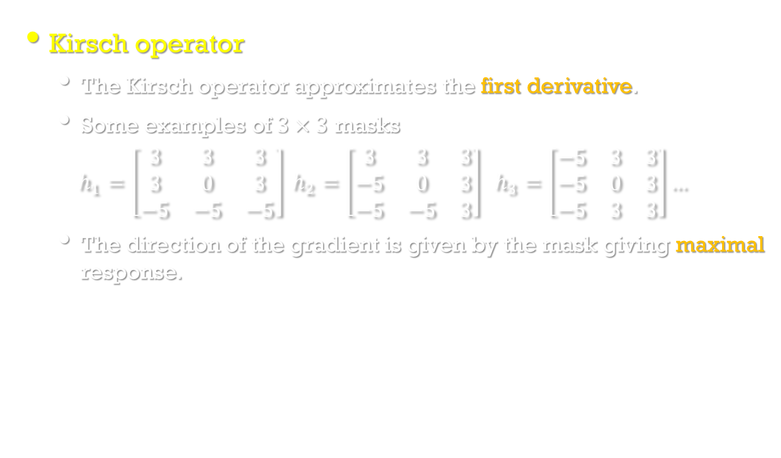
Edge detectors
Kirsch operator
The Kirsch operator approximates the first derivative.
Some examples of $3×3$ masks
$$h_{1}=\left[\begin{matrix}3 & 3 & 3 \\ 3 & 0 & 3 \\ −5 & −5 & −5\end{matrix}\right] h_{2}=\left[\begin{matrix}3 & 3 & 3 \\ −5 & 0 & 3 \\ −5 & −5 & 3\end{matrix}\right] h_{3}=\left[\begin{matrix}−5 & 3 & 3 \\ −5 & 0 & 3 \\ −5 & 3 & 3\end{matrix}\right]…$$
The direction of the gradient is given by the mask giving maximal response.

Slide 16
Zero-crossings of the second derivative
Image Processing, Analysis, and Machine Vision, 4th Edition Sonka, Hlavac & Boyle
Zero-crossings
An edge detection technique using the second derivative.
The first derivative of the image function should have an extremum at the position corresponding to the image.
The second derivative should be zero at the same position.
However, it is much easier and more precise to find a zero-crossing position than an extremum.

Slide 17
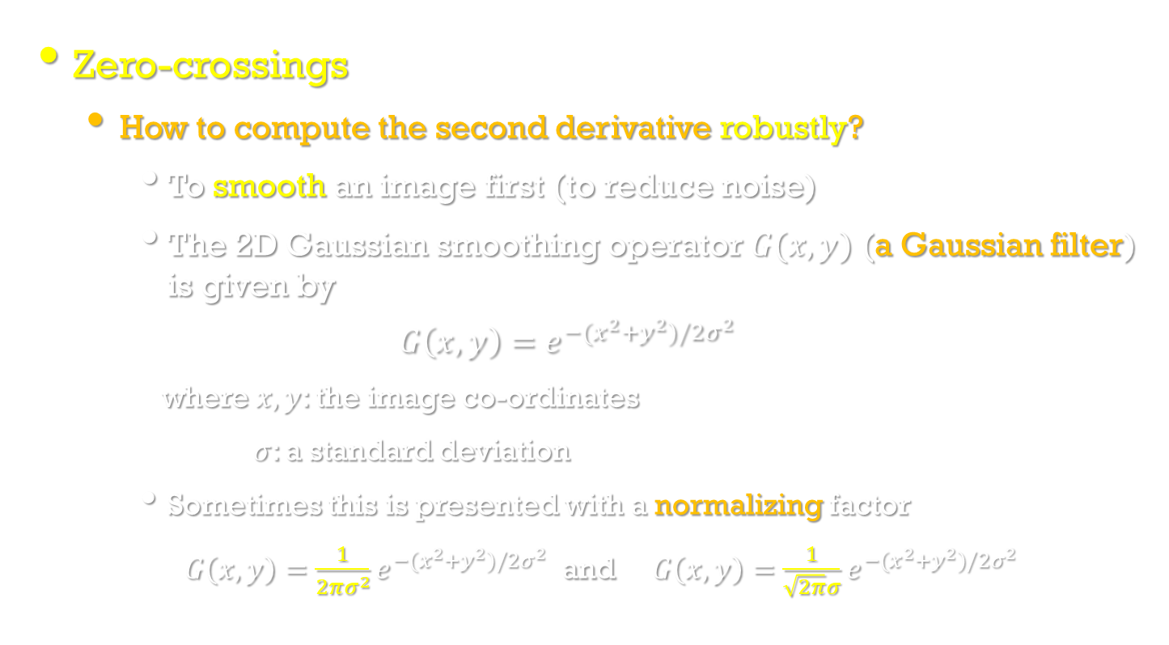
Zero-crossings of the second derivative
Image Processing, Analysis, and Machine Vision, 4th Edition Sonka, Hlavac & Boyle
Zero-crossings
How to compute the second derivative robustly?
To smooth an image first (to reduce noise)
The 2D Gaussian smoothing operator $G(x,y)$ (a Gaussian filter) is given by
$$G\left(x,y\right)=e^{−(x^{2}+y^{2})/2σ^{2}}$$
where $x, y$: the image co-ordinates
$σ$: a standard deviation
Sometimes this is presented with a normalizing factor
$G\left(x,y\right)=\frac{1}{2πσ^{2}}e^{−(x^{2}+y^{2})/2σ^{2}}$ and $G\left(x,y\right)=\frac{1}{\sqrt{2π}σ}e^{−(x^{2}+y^{2})/2σ^{2}}$

Slide 18
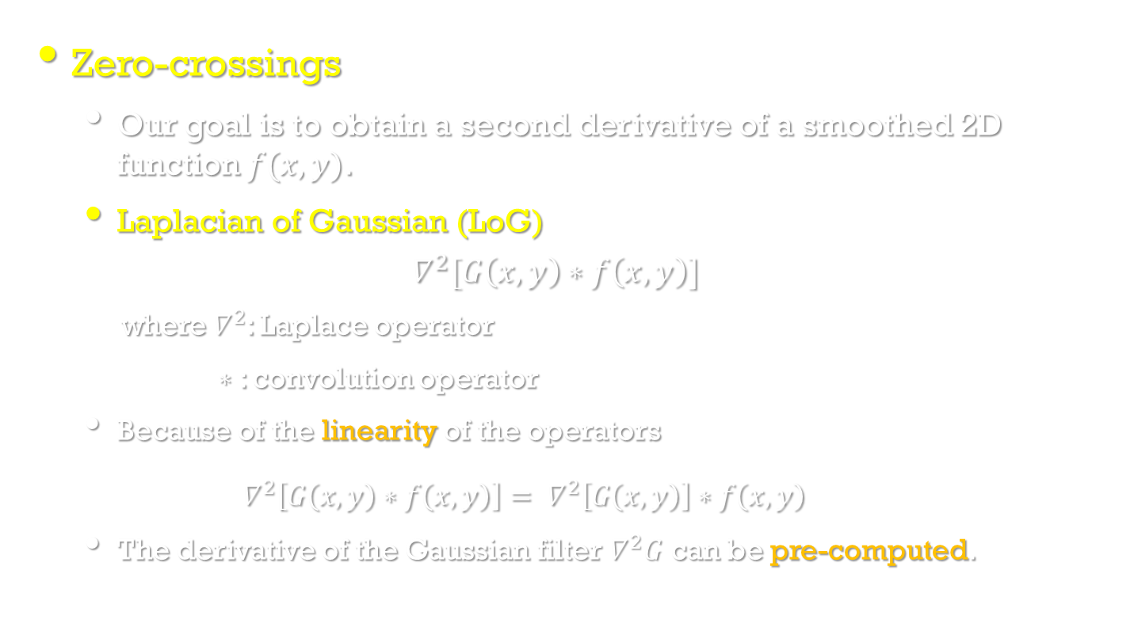
Zero-crossings of the second derivative
Image Processing, Analysis, and Machine Vision, 4th Edition Sonka, Hlavac & Boyle
Zero-crossings
Our goal is to obtain a second derivative of a smoothed 2D function $f(x,y)$.
Laplacian of Gaussian (LoG)
$$∇^{2}[G\left(x,y\right)∗f\left(x,y\right)]$$
where $∇^{2}$: Laplace operator
$∗$: convolution operator
Because of the linearity of the operators
$∇^{2}\left[G\left(x,y\right)∗f\left(x,y\right)\right]= ∇^{2}\left[G\left(x,y\right)\right]∗f\left(x,y\right)$
The derivative of the Gaussian filter $∇^{2}G$ can be pre-computed.

Slide 19
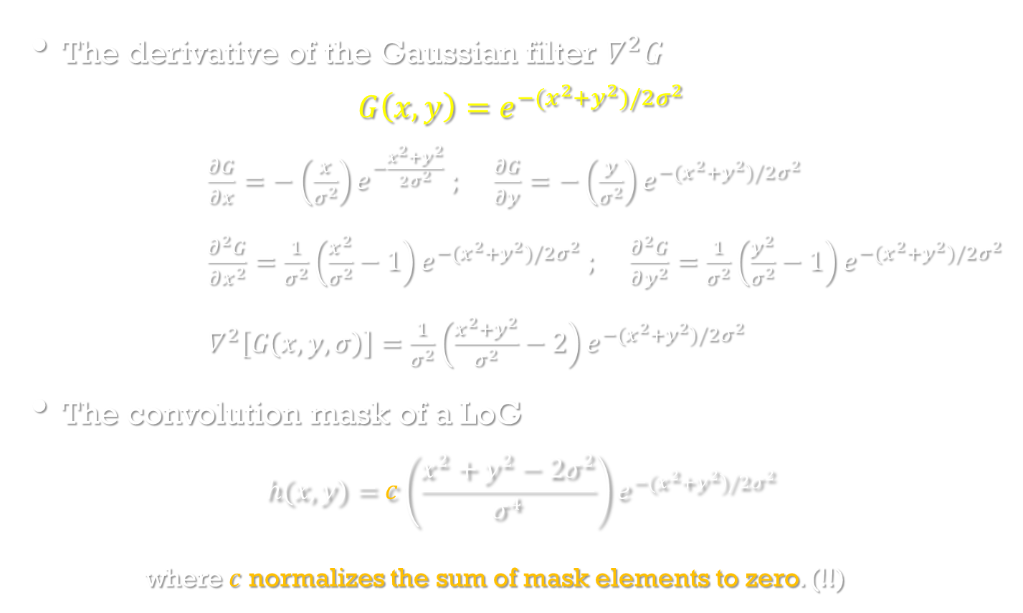
Zero-crossings of the second derivative
Image Processing, Analysis, and Machine Vision, 4th Edition Sonka, Hlavac & Boyle
The derivative of the Gaussian filter $∇^{2}G$
$$G\left(x,y\right)=e^{−(x^{2}+y^{2})/2σ^{2}}$$
$\frac{∂G}{∂x}=−\left(\frac{x}{σ^{2}}\right)e^{−\frac{x^{2}+y^{2}}{2σ^{2}}} ; \frac{∂G}{∂y}=−\left(\frac{y}{σ^{2}}\right)e^{−(x^{2}+y^{2})/2σ^{2}}$
$\frac{∂^{2}G}{∂x^{2}}=\frac{1}{σ^{2}}\left(\frac{x^{2}}{σ^{2}}−1\right)e^{−(x^{2}+y^{2})/2σ^{2}} ; \frac{∂^{2}G}{∂y^{2}}=\frac{1}{σ^{2}}\left(\frac{y^{2}}{σ^{2}}−1\right)e^{−(x^{2}+y^{2})/2σ^{2}}$
$∇^{2}\left[G\left(x,y,σ\right)\right]=\frac{1}{σ^{2}}\left(\frac{x^{2}+y^{2}}{σ^{2}}−2\right)e^{−(x^{2}+y^{2})/2σ^{2}}$
The convolution mask of a LoG
$$h(x,y)=c\left(\frac{x^{2}+y^{2}−2σ^{2}}{σ^{4}}\right)e^{−(x^{2}+y^{2})/2σ^{2}}$$
where $c$ normalizes the sum of mask elements to zero. (!!)

Slide 20
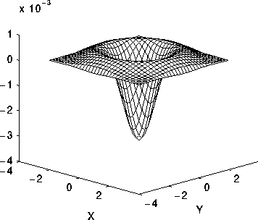
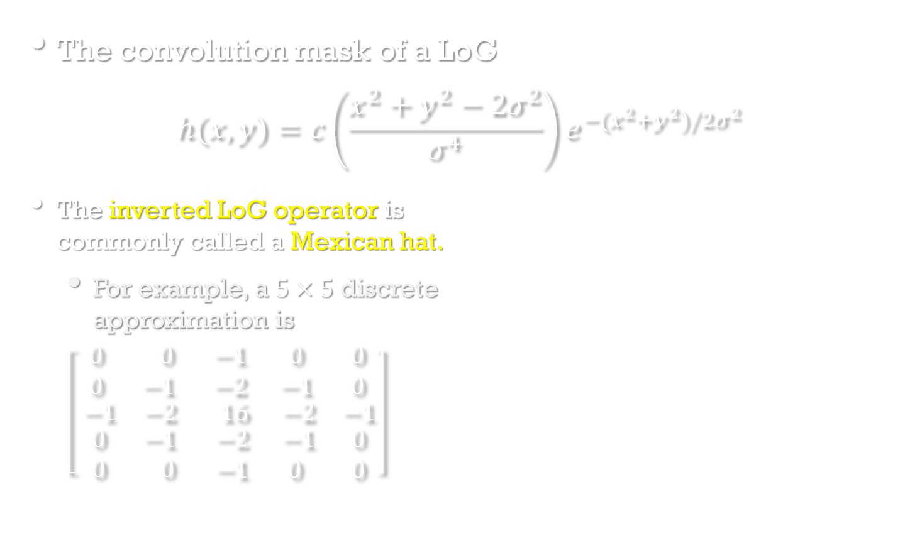
Zero-crossings of the second derivative
Image Processing, Analysis, and Machine Vision, 4th Edition Sonka, Hlavac & Boyle
The convolution mask of a LoG
$$h(x,y)=c\left(\frac{x^{2}+y^{2}−2σ^{2}}{σ^{4}}\right)e^{−(x^{2}+y^{2})/2σ^{2}}$$
The inverted LoG operator is commonly called a Mexican hat.
For example, a $5×5$discrete approximation is
$$\left[ \begin{matrix}\begin{matrix} 0 & 0 \\ 0 & −1\end{matrix} & \begin{matrix}−1 & 0 & 0 \\ −2 & −1 & 0\end{matrix} \\ \begin{matrix}−1 & −2 \\ \begin{matrix}0 \\ 0\end{matrix} & \begin{matrix}−1 \\ 0\end{matrix}\end{matrix} & \begin{matrix} 16 & −2 & −1 \\ \begin{matrix} −2 \\ −1\end{matrix} & \begin{matrix} −1 \\ 0\end{matrix} & \begin{matrix}0 \\ 0\end{matrix}\end{matrix}\end{matrix}\right]$$

Slide 21
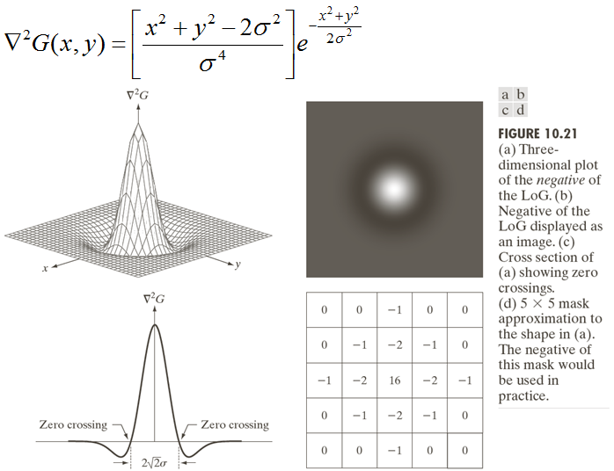

Slide 22
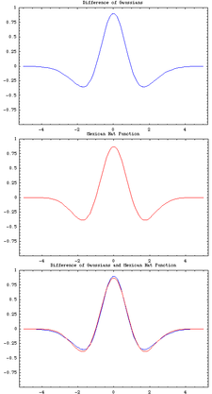
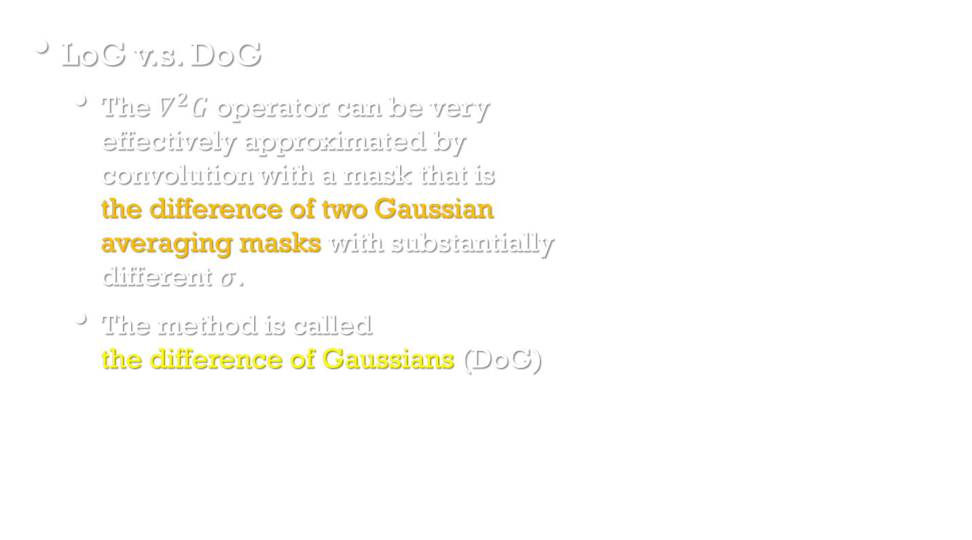
Zero-crossings of the second derivative
Image Processing, Analysis, and Machine Vision, 4th Edition Sonka, Hlavac & Boyle
LoG v.s. DoG
The $∇^{2}G$ operator can be very effectively approximated by convolution with a mask that is the difference of two Gaussian averaging masks with substantially different $σ$.
The method is called the difference of Gaussians (DoG)
DoG
Mexican
hat
Comparison of difference of Gaussian with Mexican hat wavelet
https://en.wikipedia.org/wiki/Difference_of_Gaussians

Slide 23
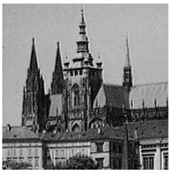
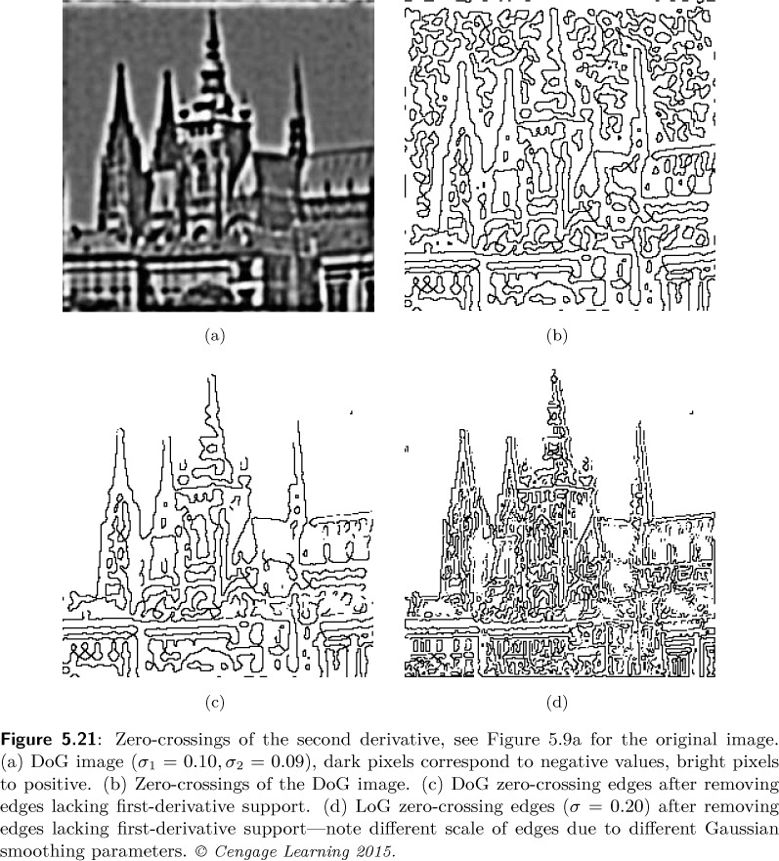
Image Processing, Analysis, and Machine Vision, 4th Edition Sonka, Hlavac & Boyle
DoG
Zero-crossings of DoG
Original image
A post-processing step to avoid detection of zero-crossings corresponding to non-significant edges in regions of almost constant gray-level will admit only those zero-crossings for which there is sufficient edge evidence from a first-derivative edge detector.
DoG zc
LoG zc

Slide 24
Scale in image processing
Image Processing, Analysis, and Machine Vision, 4th Edition Sonka, Hlavac & Boyle
Different description levels are easily interpreted as different scales in the domain of digital images.
to eliminate fine scale noise
to separate events at different scales
Scale-independent description of object can reduce the ambiguity.
Three examples of the application of multiple scale description
To find the curve segments that represents the underlying structure of the scene needs to be found.
For example, the figure may be interpreted as a closed curve, or be described as two intersecting straight lines.
Scale-space filtering
Canny edge detector

Slide 25
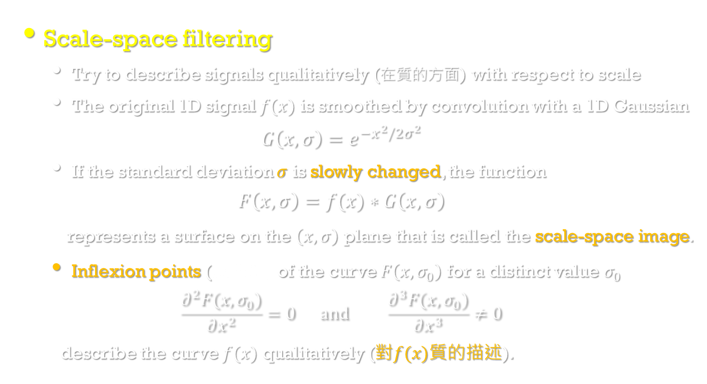
Scale in image processing
Image Processing, Analysis, and Machine Vision, 4th Edition Sonka, Hlavac & Boyle
Scale-space filtering
Try to describe signals qualitatively (在質的方面) with respect to scale
The original 1D signal $f(x)$ is smoothed by convolution with a 1D Gaussian
$$G\left(x,σ\right)=e^{−x^{2}/2σ^{2}}$$
If the standard deviation $σ$ is slowly changed, the function
$$F\left(x,σ\right)=f(x)∗G\left(x,σ\right)$$
represents a surface on the $\left(x,σ\right)$ plane that is called the scale-space image.
Inflexion points (反曲點) of the curve $F\left(x,σ_{0}\right)$ for a distinct value $σ_{0}$
$$\frac{∂^{2}F(x,σ_{0})}{∂x^{2}}=0 and \frac{∂^{3}F(x,σ_{0})}{∂x^{3}}≠0$$
describe the curve $f(x)$ qualitatively (對$f(x)$質的描述).

Slide 26
Scale-space filtering
Andrew P. Witkin.
Fai'rchi'ld Laboratory for Artiﬁcial Intelligence Research

Slide 27
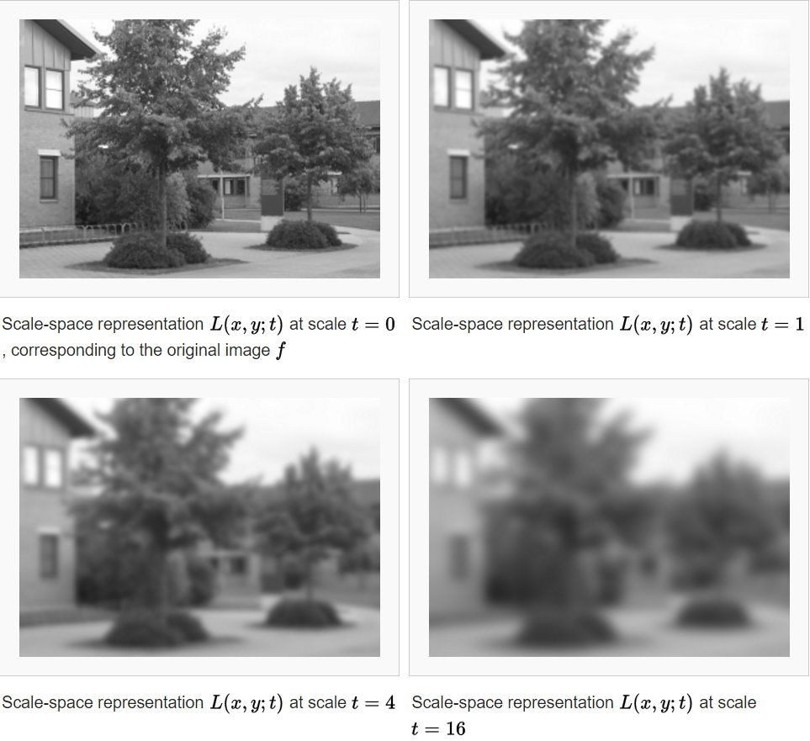

An example of 2D scale-space representation
Larger scale t (or $σ$): fewer noises, less precise in location
Smaller scale t (or $σ$): more noises, more precise in location
https://en.wikipedia.org/wiki/Scale_space

Slide 28
Canny edge detection
Image Processing, Analysis, and Machine Vision, 4th Edition Sonka, Hlavac & Boyle
Canny edge detection
It is optimal for step edges corrupted by white noise.
The optimality of the detector is related to three criteria.
The detection criterion
The important edges should not be missed.
There should be no spurious (假的) edges.
The localization criterion
The distance between the actual and located position of the edge should be minimal.
The one response criterion
Minimizing multiple responses to a single edge

Slide 29
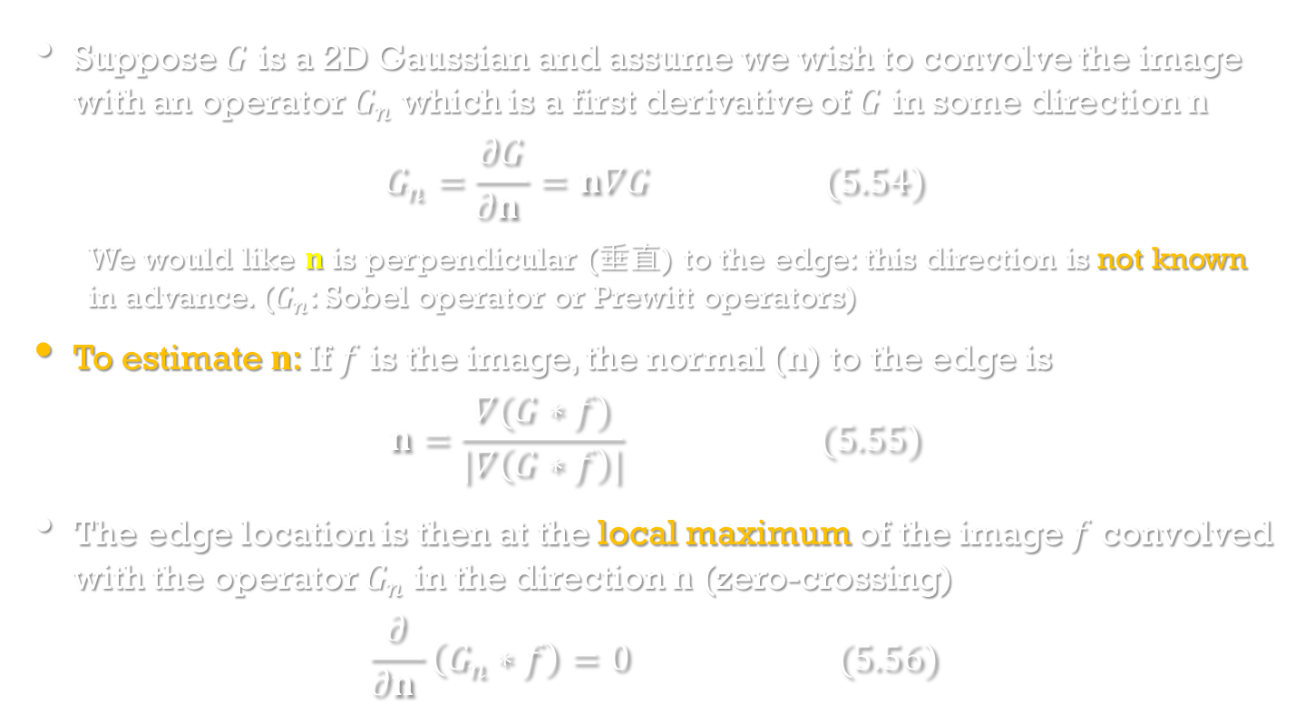
Canny edge detection
Image Processing, Analysis, and Machine Vision, 4th Edition Sonka, Hlavac & Boyle
Suppose $G$ is a 2D Gaussian and assume we wish to convolve the image with an operator $G_{n}$ which is a first derivative of $G$ in some direction $n$
$$G_{n}=\frac{∂G}{∂n }=n∇G (5.54)$$
We would like $n$ is perpendicular (垂直) to the edge: this direction is not known in advance. ($G_{n}$: Sobel operator or Prewitt operators)
To estimate $n$: If $f$ is the image, the normal ($n$) to the edge is
$$n=\frac{∇(G∗f)}{|∇\left(G∗f\right)|} (5.55)$$
The edge location is then at the local maximum of the image $f$ convolved with the operator $G_{n}$ in the direction $n$ (zero-crossing)
$$\frac{∂}{∂n }\left(G_{n}∗f\right)=0 (5.56)$$

Slide 30
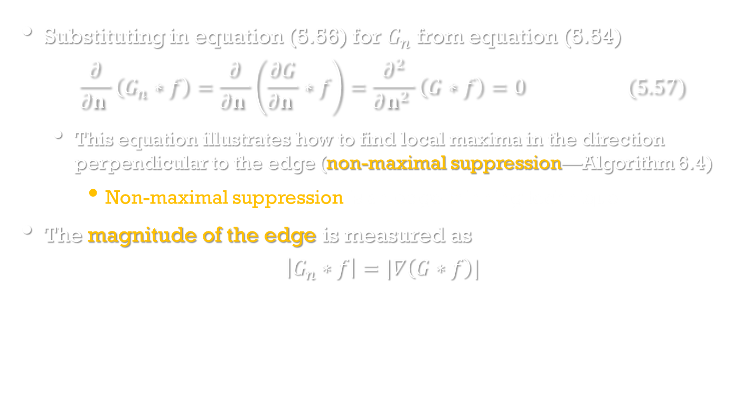
Canny edge detection
Image Processing, Analysis, and Machine Vision, 4th Edition Sonka, Hlavac & Boyle
Substituting in equation (5.56) for $G_{n}$ from equation (5.54)
$$\frac{∂}{∂n }\left(G_{n}∗f\right)=\frac{∂}{∂n }\left(\frac{∂G}{∂n }∗f\right)=\frac{∂^{2}}{∂n^{2} }\left(G∗f\right)=0 (5.57)$$
This equation illustrates how to find local maxima in the direction perpendicular to the edge (non-maximal suppression—Algorithm 6.4)
Non-maximal suppression is an edge thinning technique.
The magnitude of the edge is measured as
$$\left|G_{n}∗f\right|=|∇\left(G∗f\right)|$$

Slide 31
Non-maximal Suppression
Non-maximal suppression is an edge thinning technique.
After applying gradient calculation, the edge extracted from the gradient value is still quite blurred. Non-maximal suppression can help to suppress all the gradient values (by setting them to 0) except the local maxima, which indicate locations with the sharpest change of intensity value.
http://ccy.dd.ncu.edu.tw/~chen/course/vision/ch6/%E5%96%AE%E5%85%83%E5%85%AD%E3%80%81%E9%82%8A%E7%B7%A3%E5%81%B5%E6%B8%AC.pdf

Slide 32
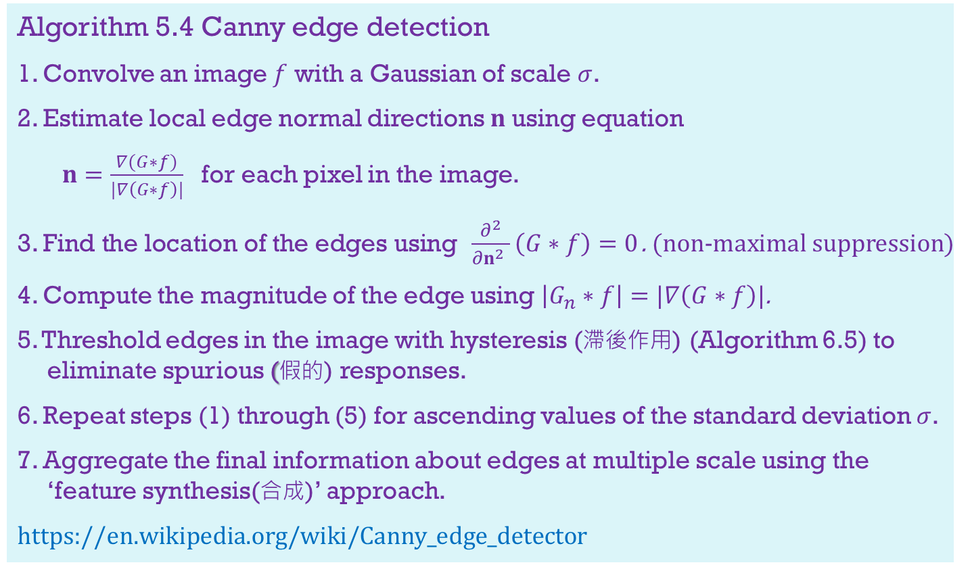
Canny edge detection
Image Processing, Analysis, and Machine Vision, 4th Edition Sonka, Hlavac & Boyle
Algorithm 5.4 Canny edge detection
1. Convolve an image $f$ with a Gaussian of scale $σ$.
2. Estimate local edge normal directions $n$using equation
$n=\frac{∇(G∗f)}{|∇\left(G∗f\right)|}$ for each pixel in the image.
3. Find the location of the edges using $\frac{∂^{2}}{∂n^{2} }\left(G∗f\right)=0$. (non-maximal suppression)
4. Compute the magnitude of the edge using $\left|G_{n}∗f\right|=|∇\left(G∗f\right)|$.
5. Threshold edges in the image with hysteresis (滯後作用) (Algorithm 6.5) to eliminate spurious (假的) responses.
6. Repeat steps (1) through (5) for ascending values of the standard deviation $σ$.
7. Aggregate the final information about edges at multiple scale using the ‘feature synthesis(合成)’ approach.
https://en.wikipedia.org/wiki/Canny_edge_detector

Slide 33
Hysteresis Thresholding
Double threshold: Select high and low threshold values
If an edge pixel’s gradient value is higher than the high threshold value, it is marked as a strong edge pixel.
If an edge pixel’s gradient value is smaller than the high threshold value and larger than the low threshold value, it is marked as a weak edge pixel.
If an edge pixel's value is smaller than the low threshold value, it will be suppressed.
Edge tracking by hysteresis (滯後作用)
Usually a weak edge pixel caused from true edges will be connected to a strong edge pixel while noise responses are unconnected.
To track the edge connection, blob analysis is applied by looking at a weak edge pixel and its 8-connected neighborhood pixels.
As long as there is one strong edge pixel that is involved in the blob, that weak edge point can be identified as one that should be preserved.
https://en.wikipedia.org/wiki/Canny_edge_detector

Slide 34
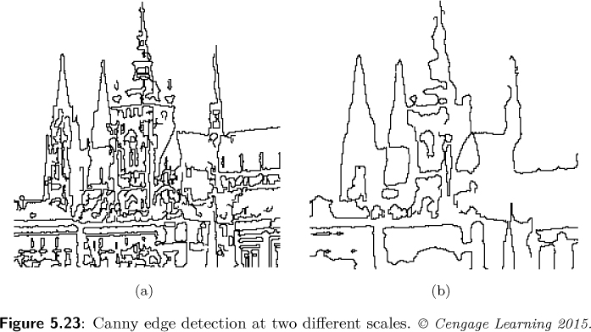
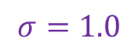
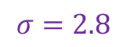
Canny edge detection
Image Processing, Analysis, and Machine Vision, 4th Edition Sonka, Hlavac & Boyle
Some examples
$$σ=1.0$$
$$σ=2.8$$

Slide 35
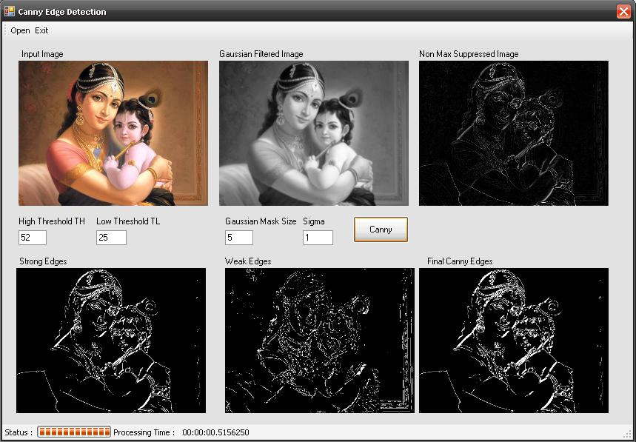
http://www.codeproject.com/Articles/93642/Canny-Edge-Detection-in-C

Slide 36
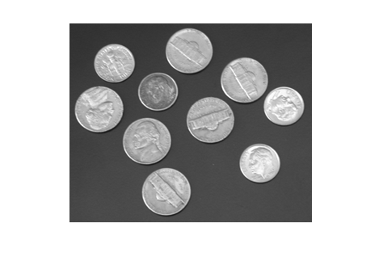
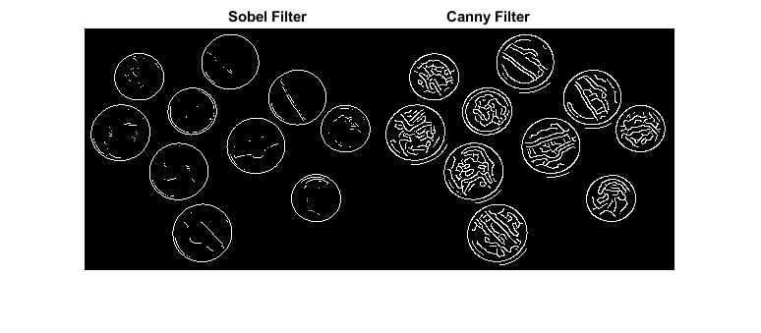
Canny edge detection
https://www.mathworks.com/examples/image/mw/images-ex48835658-detect-edges-in-images

Slide 37
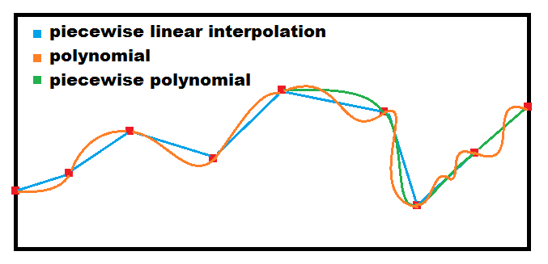
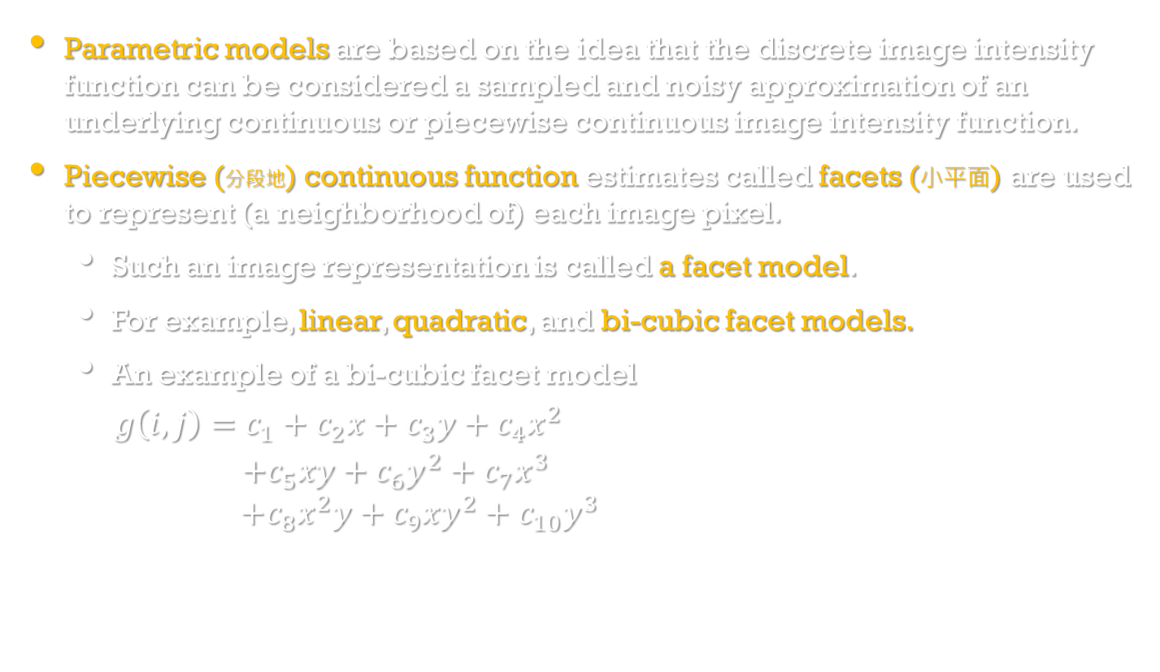
Parametric edge models
Image Processing, Analysis, and Machine Vision, 4th Edition Sonka, Hlavac & Boyle
Parametric models are based on the idea that the discrete image intensity function can be considered a sampled and noisy approximation of an underlying continuous or piecewise continuous image intensity function.
Piecewise (分段地) continuous function estimates called facets (小平面) are used to represent (a neighborhood of) each image pixel.
Such an image representation is called a facet model.
For example, linear, quadratic, and bi-cubic facet models.
An example of a bi-cubic facet model
$g\left(i,j\right)=c_{1}+c_{2}x+c_{3}y+c_{4}x^{2}$
$+c_{5}xy+c_{6}y^{2}+c_{7}x^{3}$
$+c_{8}x^{2}y+c_{9}xy^{2}+c_{10}y^{3}$
https://stackoverflow.com/questions/30433391/how-can-i-produce-multi-point-linear-interpolation/30438865#30438865

Slide 38
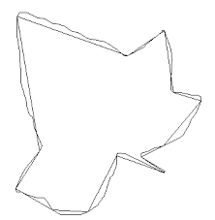
Parametric edge models
Image Processing, Analysis, and Machine Vision, 4th Edition Sonka, Hlavac & Boyle
Once the facet model parameters are available for each image pixel, edges can be detected as extrema of the first directional derivative and/or zero-crossings of the second directional derivative of the local continuous facet model functions.
Edge detectors based on parametric models describe edges more precisely than convolution-based edge detectors.
They carry the potential for subpixel edge localization.
However, their computational requirements are much higher.
http://cs.joensuu.fi/~koles/approximation/Ch3_5.html

Slide 39
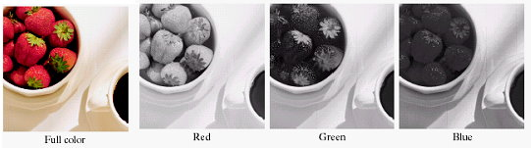
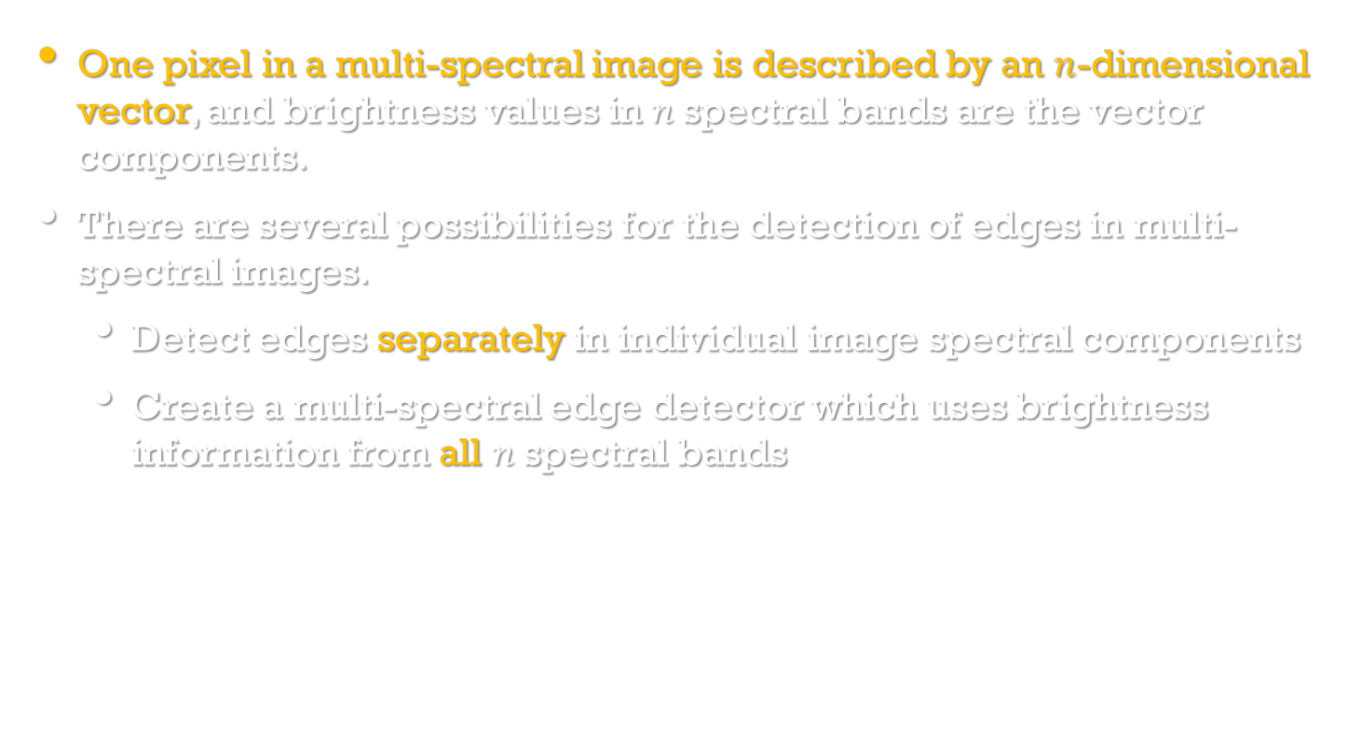
Edges in multi-spectral images
Image Processing, Analysis, and Machine Vision, 4th Edition Sonka, Hlavac & Boyle
One pixel in a multi-spectral image is described by an $n$-dimensional vector, and brightness values in $n$spectral bands are the vector components.
There are several possibilities for the detection of edges in multi-spectral images.
Detect edges separately in individual image spectral components
Create a multi-spectral edge detector which uses brightness information from all $n$spectral bands

Slide 40
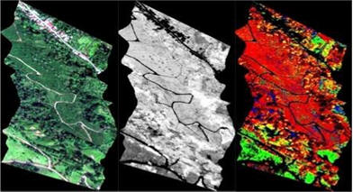
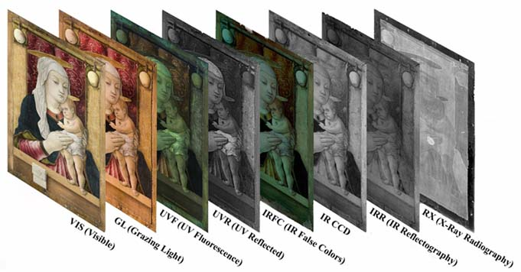
http://www.agricultureuavs.com/photos_multispectral_camera.htm
http://patingtoci24.soup.io/post/390611507/Download-multispectral-imaging

